Slide 1
Agricultural Technology
Regional Industry Advisory
April 26th, 2024

Slide 2
Housekeeping
Enable your video camera (optional)
Please stay on unless you are called on to ask a question
Submit all questions and commentary using the chat function
This meeting will be recorded and will be provided as part of the post-meeting materials

Slide 3
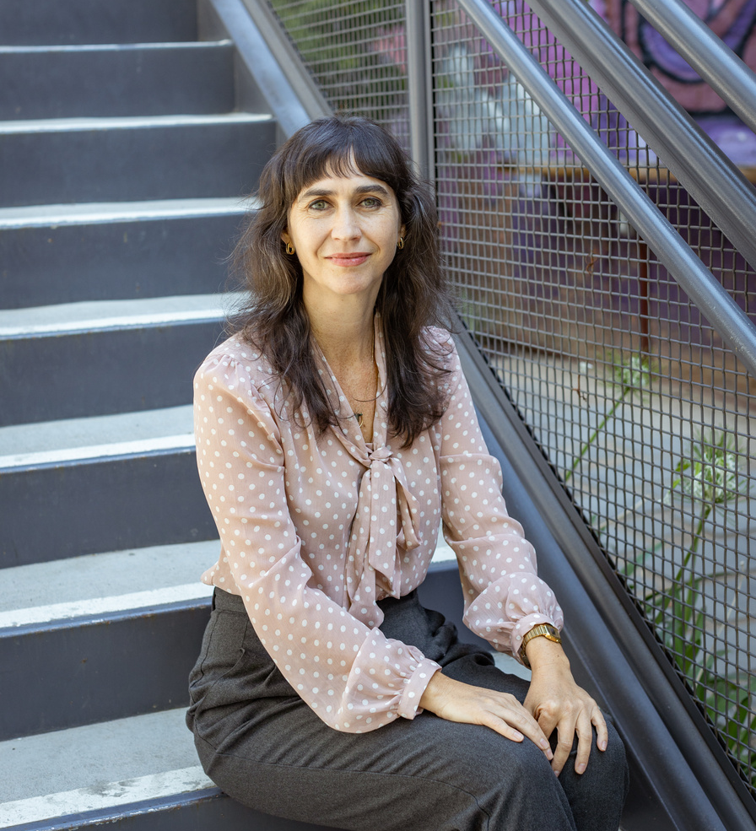
Welcome & Introduction
Hilary Tellesen, Valley Vision
Senior Project Manager
Diangelo Andrews, Valley Vision
Project Associate

Slide 4
Thank You!
Josh Sweigert
Julie Muir
Director of Employer Partnership
Agriculture, Water, Environmental Technology
Director of Employer Partnership
Manufacturing and Automation

Slide 5
9:00 PM: Welcome and Introduction
9:10 PM: Agriculture in Greater Sacramento: A Labor Market Assessment
9:40 PM: Industry Panel Discussion
10:30 PM: Regional Programs
10:45PM: Networking Breakout Rooms
Agenda

Slide 6
Thank you
to all of our supporters

Slide 7
Agriculture in Greater Sacramento: A Labor Market Assessment
Ebony Benzing, Director North (Greater Sacramento) Center of Excellence for Labor Market Research, Hosted By Los Rios Community College District

Slide 30
Industry Panel Discussion
Jose Alvarez
Trudi Hughes
Amy Vedmore
Organizational Effectiveness Director at
Del Monte Foods
President/CEO at
California League of Food Producers
Director Supply Chain Integration at Blue Diamond Growers
Diane Robinson
Greg Ahart
Human Resources Manager at TOMRA Foods
Vice President of Operations at Superior Farms

Slide 31
Program Offerings and College Partnerships
Presented By Julie Muir and Josh Sweigert

Slide 32
Program Offerings and College Partnerships
Manufacturing Technology/Machining & Welding
AS Degrees:
Manufacturing Technology and Machining
https://yc.yccd.edu/programs/manufacturing-technology-machining/
Welding
https://yc.yccd.edu/programs/welding/
Certificates:
Advanced Welding Technologies
Fabrication and Manufacturing Methods
Introductory Welding Technologies
Program Highlights:
Weld Camp 2024: 10 High Schools attended
Project MFG Advanced Manufacturing Regional Competition
Our manufacturing team traveled to the College of Southern Nevada, competing with 80 schools. Yuba College ranked 15ᵗʰ, and we are possibly moving into the Final Four. We are still waiting for the results!

Slide 45
Upcoming Events
Hospitality, Culinary, and Tourism Advisory on Point of Sales Systems
May 10 from 9-11 am

Slide 46
Please Join Your Networking Breakout Room
Manufacturing Discussion Group
Agriculture Discussion Group
For more information, please contact:
Julie Muir, Director of Employer Partnership
MuirJ@scc.losrios.edu
Josh Sweigert, Director of Employer Partnership
jsweigert@shastacollege.edu
Hilary Tellesen, Project Leader
hilary.tellesen@valleyvision.org
DiAngelo Andrews, Project Associate
diangelo.andrews@valleyvision.org
Fill out our survey and let us know what you think

