Slide 1


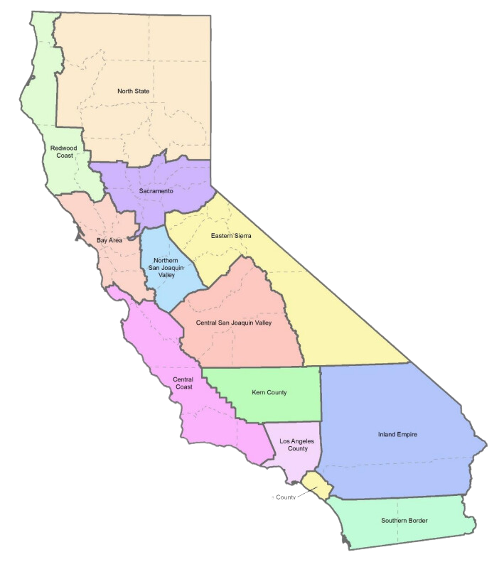
California Jobs First
(CERF)
$600M program statewide advancing regional economies
Notes:
CERF came about as a response to the COVID crisis. People had very different experiences. The recovery needed to be different and the approach to economic development overall.
No longer business as usual

Slide 2




California Jobs First (CERF)
Capital Region
High Quality Jobs
Equity-centered
  Colusa
  El Dorado
  Nevada
  Placer
  Sacramento
  Sutter
  Yolo
  Yuba
Low carbon transition
Catalyze Investments
Notes:
Capital Region
- eight county region encompassing Colusa, El Dorado, Nevada, Placer, Sacramento, Sutter, Yolo and Yuba counties
High quality jobs
Equity-centered
Low carbon transition
Catalyze investments

Slide 3


A Pivotal Moment
The Challenges
Increasing economic disparities across all types of demographics Increasing negative impacts to environment and health due to climate crisis
Notes:
We’re at a pivotal moment.
As economic disparities continue to deepen and economies shift to climate resilient jobs, transforming entire sectors of industries, we cannot leave people behind.
Increasing disparities
Negative impacts to environment and health due to climate crisis

Slide 4


A Pivotal Moment
The Solution
Create a shared regional vision Center the voices of those who are experiencing disparities Create more high quality jobs in sustainable industries
Notes:
The Solution
Create a shared regional vision
Center the voices of those who are experience disparities
Create more high quality jobs in sustainable industries

Slide 5


A Pivotal Moment
The Opportunity
Through collaboration we can build a stronger region to bring state, federal and philanthropic investments back home.
Notes:
To leverage this opportunity to set our region and communities up to thrive for years to come.

Slide 6




Goals for our Region
Create a Collaborative
Produce a regional roadmap for economic development
Attract investments into the region
Enable the creation of accessible high quality jobs
Enabling our region to make collective decisions
Prioritizing the creation of accessible, high-quality jobs in sustainable industries
From diverse sources to maximize impact
To support economic growth and equity
Notes:
Goals for our region
Create a collaborative for collective decision making
Produce a regional roadmap for economic development - a priority list of industry sectors projects that maximize opportunity to uplift our region
Attract investment into the region from diverse sources to maximize impact
Enable the creation of accessible high quality jobs to support economic growth and equity

Slide 7



Regional Progress
Our region’s efforts are already underway. Together our eight counties have:
Begun intensive research efforts to inform decision making
Secured $5M in planning dollars
Established a collaborative of
130+ orgs
Funded 18 other organizations with 2.2M to conduct this work
Notes:
Regional progress so far
Secured $5 million in planning dollars
Established a collaborative of over 130 orgs
Funded 18 other orgs with $2.2 million to conduct this work
Begun intensive research with partners including Cities GPS, a Brookings affiliated research partners, to inform decision making

Slide 8
What We’re Learned So Far
Early Data from
California Jobs First Regional Economic Analysis
Notes:
Introduce and/or transition to Ebony

Slide 9
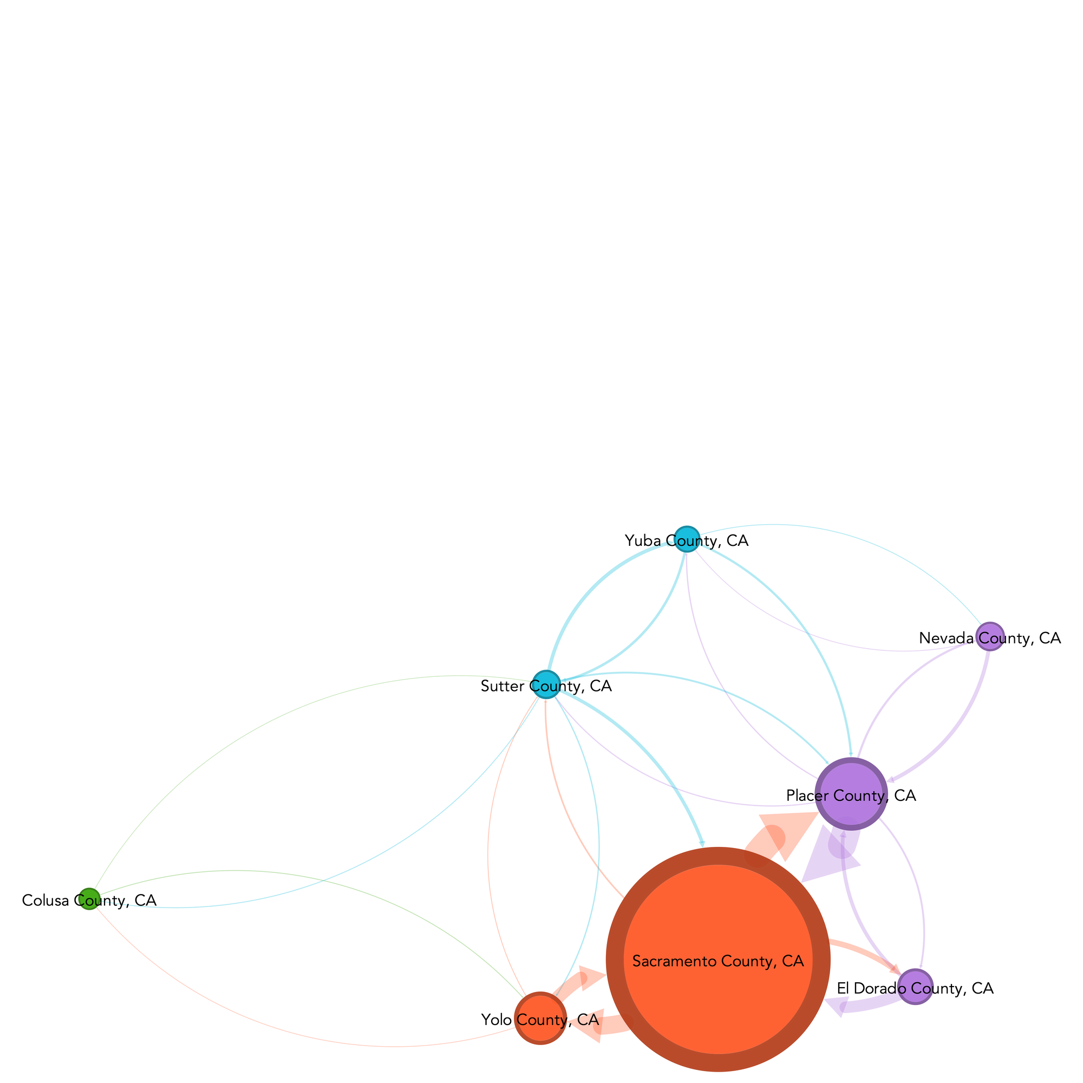
We Are Connected, Physically and Economically
Regional economies are typically identified by analyzing commuting patterns. Counties with high levels of inter-county commuting indicate a common labor market.
Direction of the flow, from the workers' county of residence to their county of work.
Size of the arrows represents the number of workers
Size of the nodes (the counties) represents the number of jobs
Note: Similarity is measured as 1 minus the Euclidean distance of shares of employment by detailed industry or occupation, multiplied by 100.
Source: Brookings and Cities GPS analysis of Lightcast estimates

Slide 10
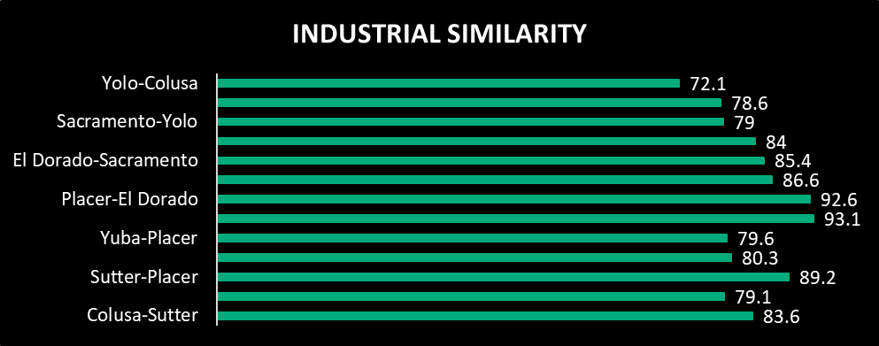
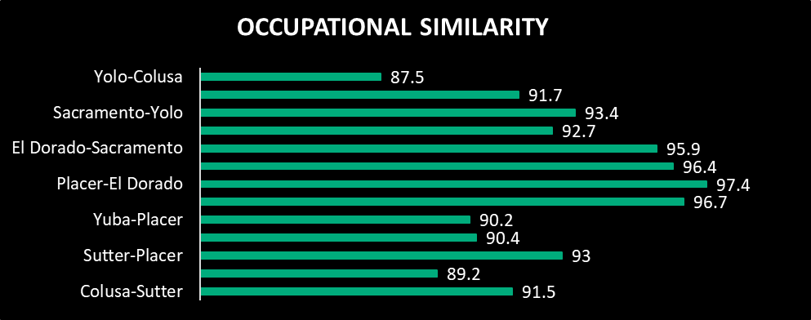
Our Connection Creates Economic Siimilarity
Economic Similarity Measures for Contiguous Counties, Capital Region 2022
Economic similarities indicate how much the counties can benefit from shared strategies for economic and workforce development.
Source: Brookings and Cities GPS analysis of Lightcast estimates
Notes:
Economic similarities indicate how much the counties can benefit from shared strategies for economic and workforce development. These findings suggest that common strategies are particularly worth exploring among counties that share a border with Sacramento County.​
Capital region counties have similar industrial structures despite differences in size and level of prosperity. Normalized measures of industrial similarity, where a value of 100 indicates identical economic structures, reveal that all eight counties are relatively similar to their neighbors.

Slide 11
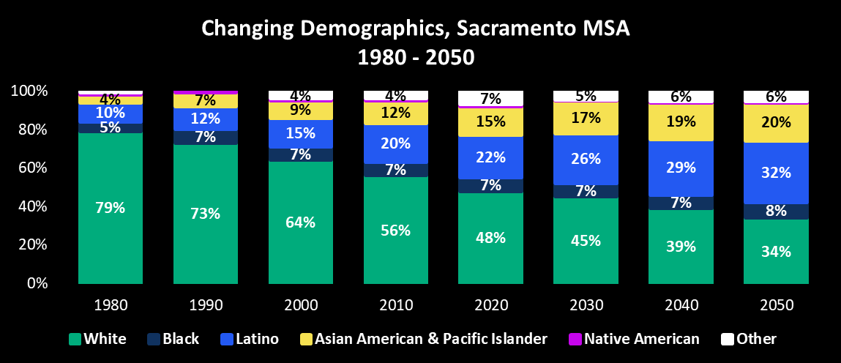
Our Region is Becoming More Diverse
Source: USC Equity Research Institute analysis of Census data

Slide 12
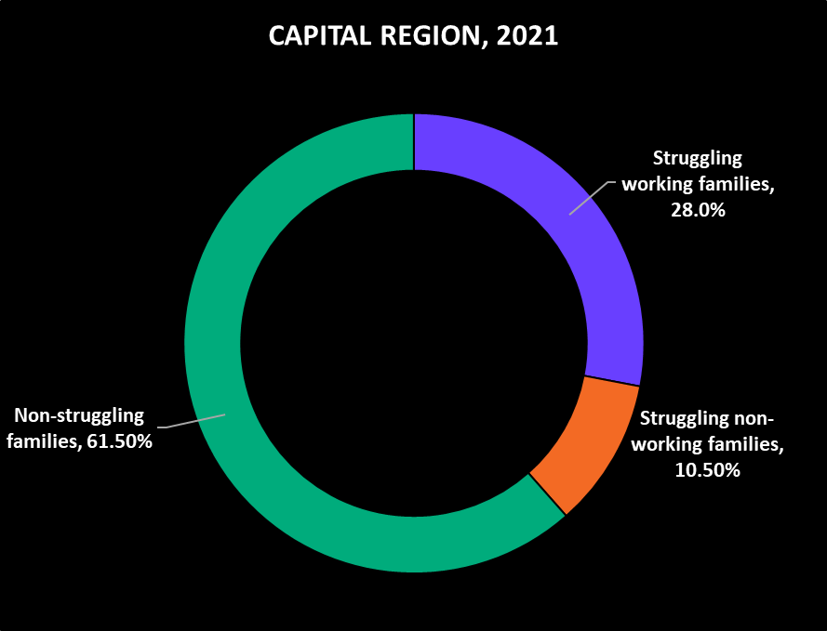
But Families Are Struggling to Make Ends Meet
At least 38% of residents in the Capital region belong to families whose income does not cover basic costs.
Of that group, most residents belong to families with at least one adult worker.
Source: Brookings and Cities GPS analysis of University of Washington Sufficiency Standard and American Community Survey 1-year public-use microdata sample, 2019 – 2021.

Slide 13
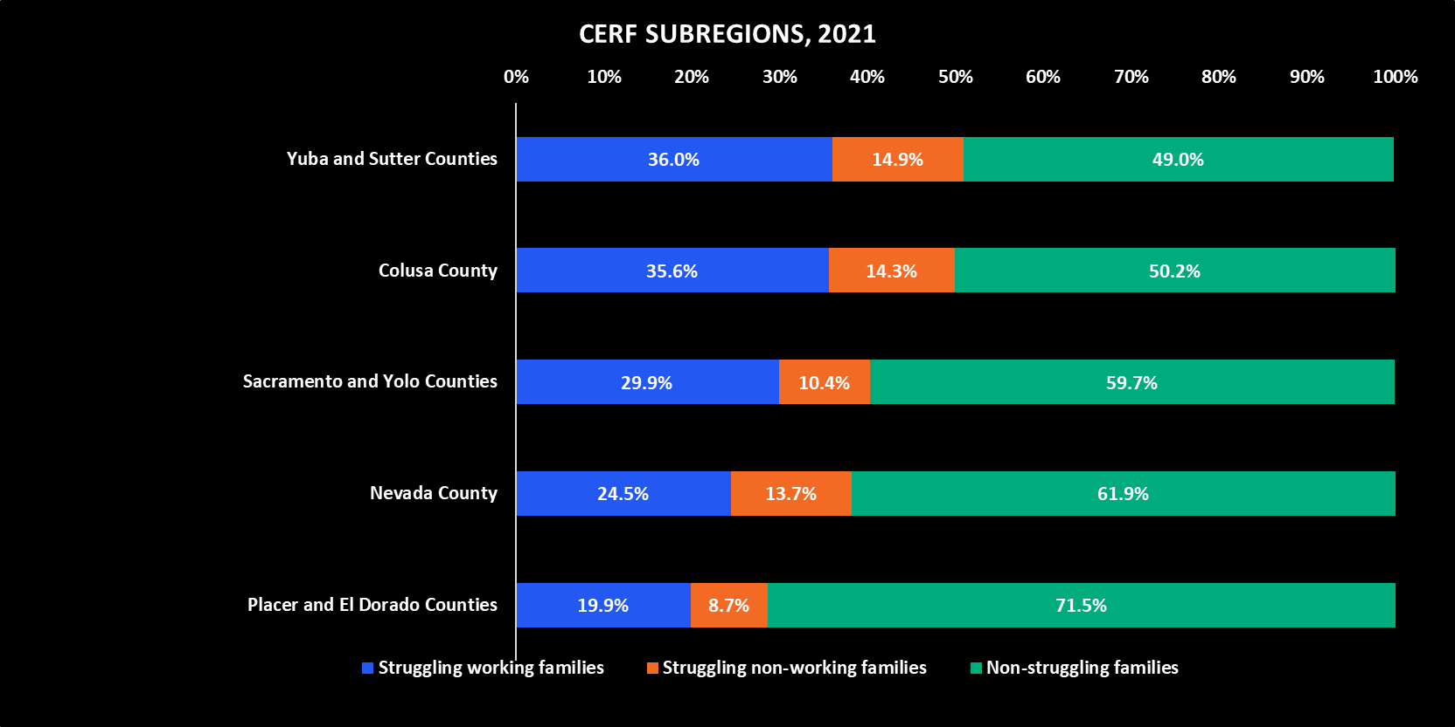
Struggling Families Vary By Subregion
The share of people who belong to struggling or "striving" working families ranges from 20% in Placer and El Dorado Counties to 36% in Yuba and Sutter Counties
Source: Brookings and Cities GPS analysis of University of Washington Sufficiency Standard and American Community Survey 1-year public-use microdata sample, 2019 – 2021.

Slide 14
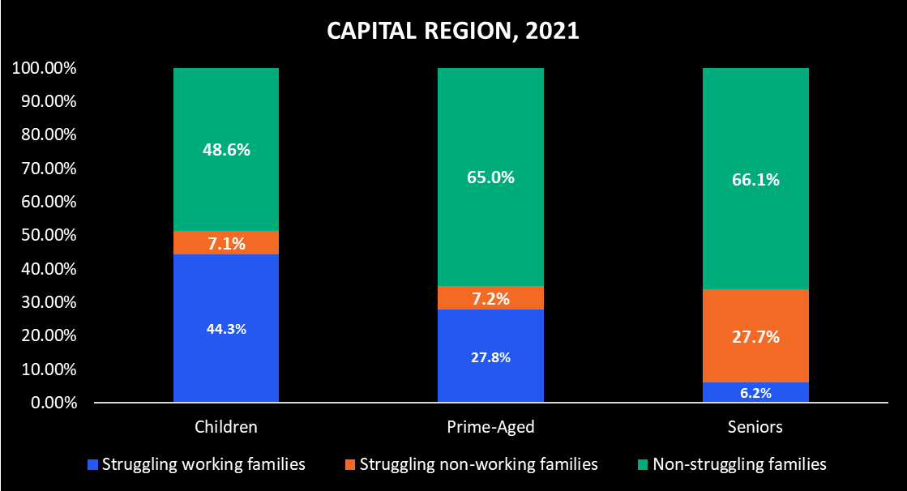
Nearly Half of Children Belong to Struggling Families
In the Capital Region, children represent the largest age group living in struggling families.
Source: Brookings and Cities GPS analysis of University of Washington Sufficiency Standard and American Community Survey 1-year public-use microdata sample, 2019 – 2021.

Slide 15
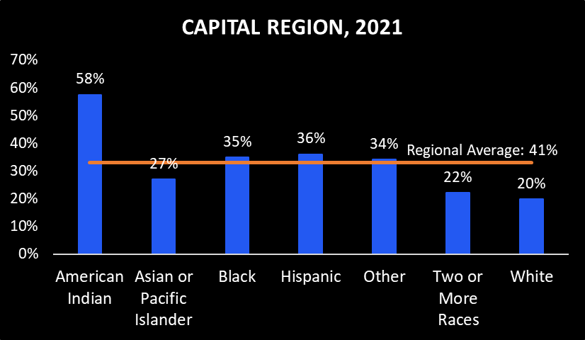
Share of Workers in Struggling Families by Race/Ethnicity
Source: Brookings and Cities GPS analysis of University of Washington Sufficiency Standard and American Community Survey 1-year public-use microdata sample, 2019 – 2021.

Slide 16


But There is Opportunity to Uplift Our Struggling Communities
POTENTIAL UNIVERSE OF GREEN JOBS IN CALIFORNIA
5.1 million
5.5 million
7%
Jobs in 2022
Jobs in 2027
5-Yr Projected
Growth
25% of all California’s jobs in 2022
383,000
612,000+
News Jobs by 2027
Annual Openings,
2021 - 2026
Source: Lightcast™. 2023.3 data run. Includes QCEW employees, Non-QCEW employees, and Self employed. Compiled by North Far North Center of Excellence for Labor Market Research. Note: These values may be overestimated due to how green jobs are defined.

Slide 17
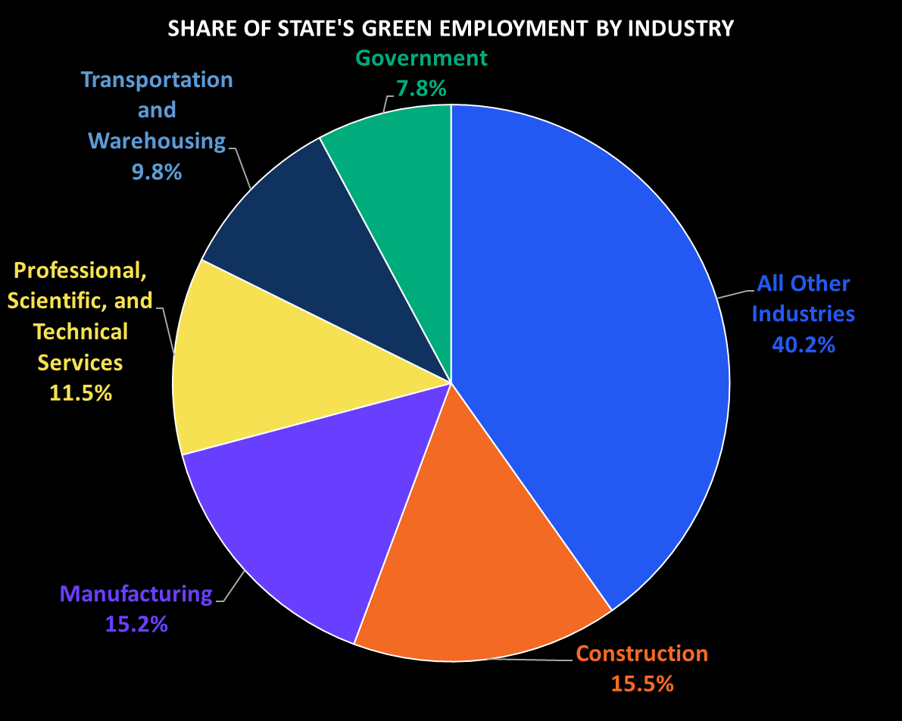
Top Industries for “Greening” Employment
Industry | “Greening” Jobs in Industry
Construction | 790,452
Manufacturing | 776,951
Professional, Scientific, and Technical Services | 588,380
Transportation and Warehousing | 503,991
Government | 400,960
Source: Lightcast™. 2023.3 data run. Includes QCEW employees, Non-QCEW employees, and Self-employed. North Far North Center of Excellence for Labor Market Research. Note: These values may be overestimated due to how green jobs are defined.

Slide 18
“’Greening” Occupations with Significant Employment in California
Green Increased Demand | Green Enhanced Skills | Green New & Emerging*
•Laborers and Freight, Stock, and Material Movers •Software Developers •Customer Service Representatives •Carpenters •Electricians | •General and Operations Managers •Heavy and Tractor-Trailer Truck Drivers •Maintenance and Repair Workers, General •Construction Laborers •Automotive Service Technicians | •Business Operations Specialists •Managers, All Other •Computer occupations, All Other •Chief Executive Officers •Compliance Officers
Source: Lightcast™. 2023.3 data run. Includes QCEW employees, Non-QCEW employees, and Self-employed. Note: *Green New & Emerging occupations listed at 6-digit SOC level. Further research needed here to understand specific roles and job titles within the Green New & Emerging occupational category. Complied by the North Far North Center of Excellence for Labor Market Research.

Slide 19
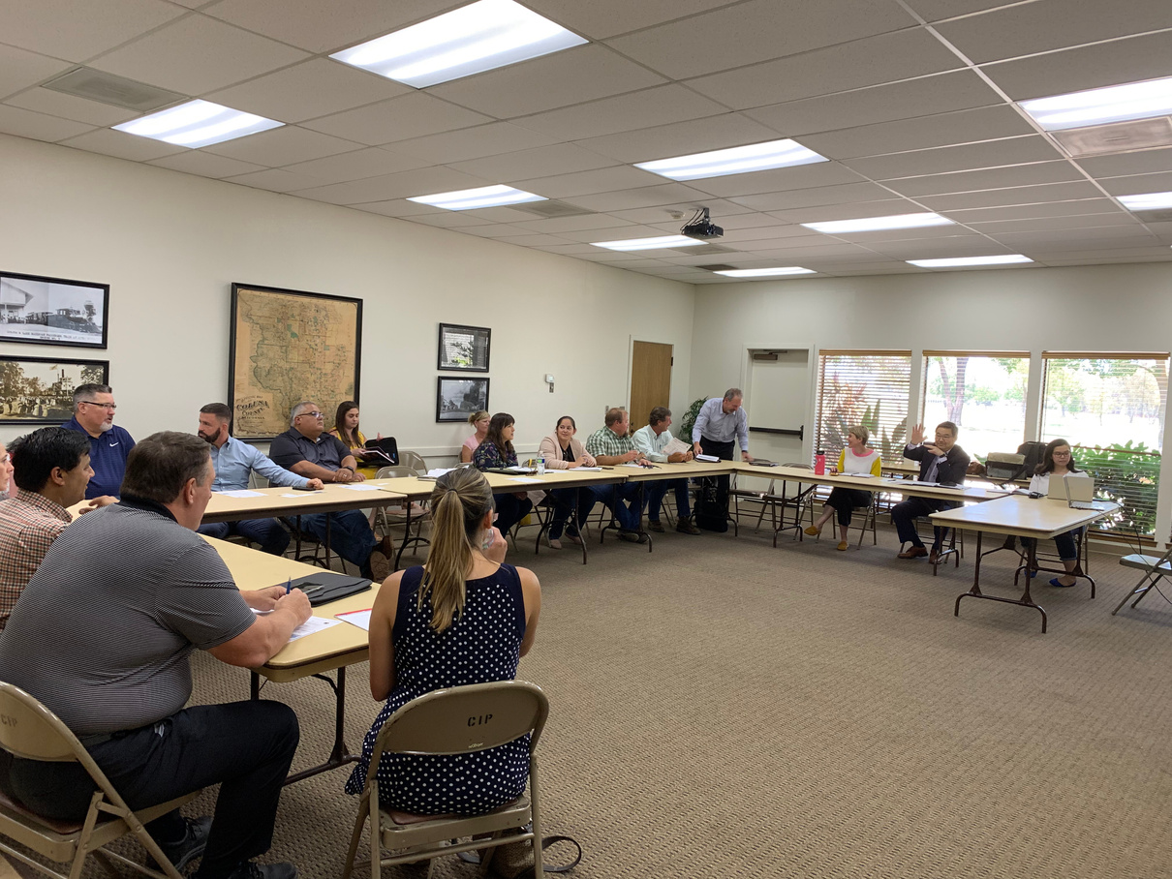
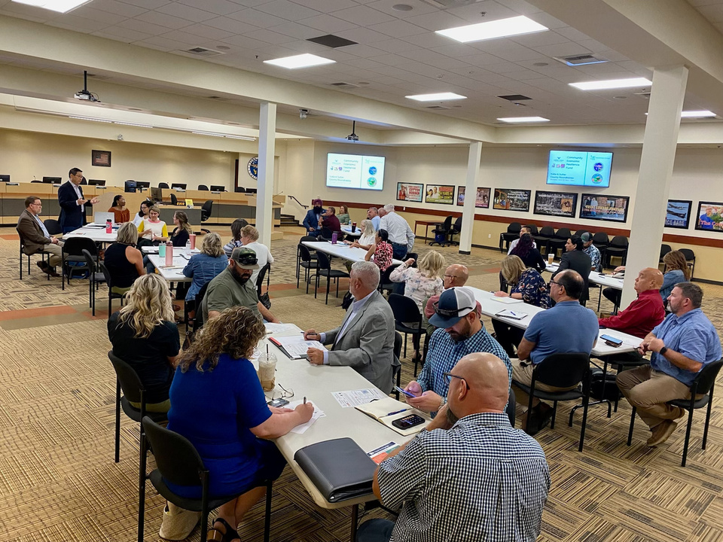
What does this mean for our region?
Notes:
Thank Ebony and our research partners for this information.
Let's bring it back home, what does this mean for us in our region.
We need to make this effort our own. We can view CERF as an opportunity to build a strong regional foundation to benefit our communities long after the September 2026 sunset of this state program.

Slide 20
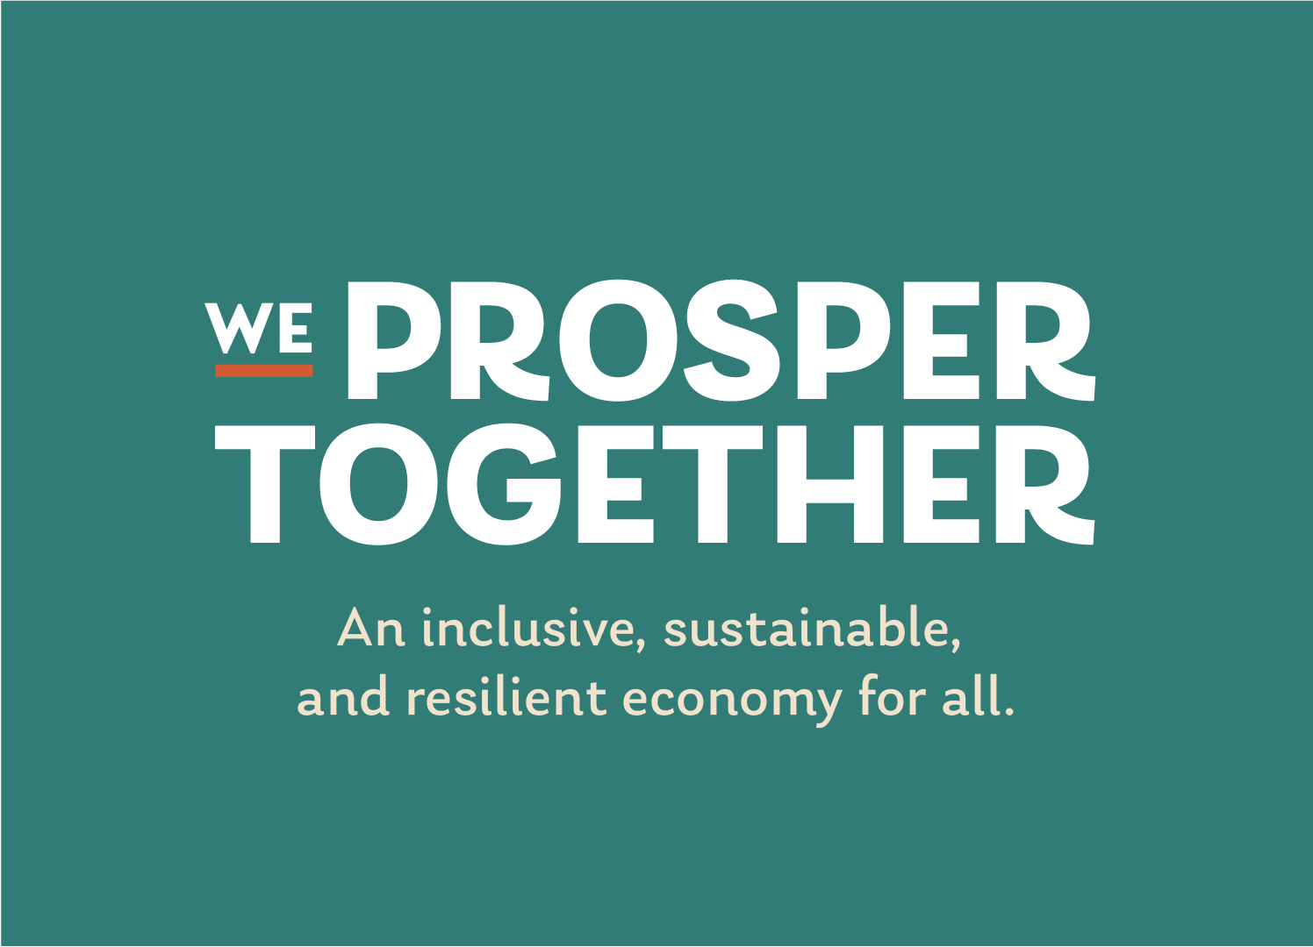
Notes:
It's important to own our unique regional identity. We Prosper Together will be how we refer to our regional effort moving forward.

Slide 21

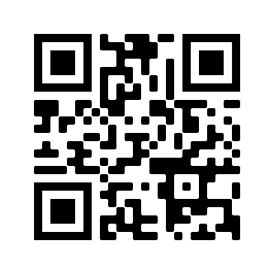


What’s Next?
Join us in creating change for our communities.
Together we can uplift our entire region.
Stay Engaged
Openness and Humility
Be an Active Champion
Notes:
What's next?
Stay engaged.
Newsletter
Join sub-regional tables
Full collaborative webinar to review initial research - Nov 13
SWOT surveys on your tables
Openness and Humility
Be an Active Champion

