Slide 1


CAPITAL REGION
Community Economic Resilience Fund (CERF)
Sacramento/Yolo Subregion Committee Meeting
October 25, 2023
Notes:
‹#›

Slide 2
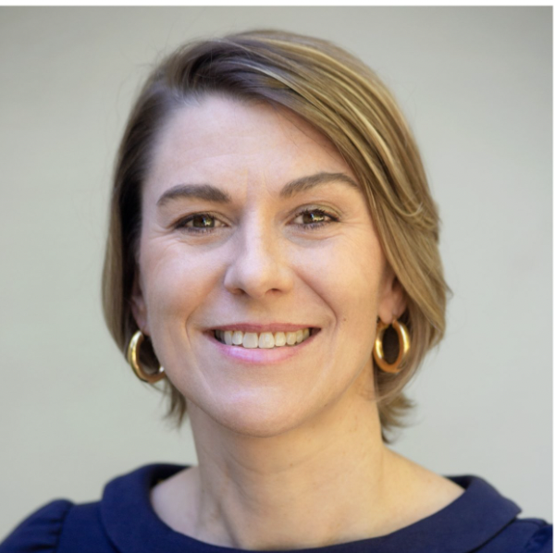

Welcome
Evan Schmidt
CEO
Valley Vision
Notes:
‹#›

Slide 3
General Housekeeping for Hybrid Meetings:
Requests for People Joining In Person
  Please sit as close as possible to the front of the room.
  Please raise your hand if you would like to make a comment.
Requests for People Joining Virtually:
  We have a second projector in Curtis Hall. Please have your cameras on so that folks in the physical space can see the virtual participants.
  Use headphones with a microphone for best audio.
  If you have a question, please type in the Chatbox.
Notes:
‹#›

Slide 4
Goals for the October Sacramento/Yolo Subregion Committee Meeting Today:
  Getting a shared understanding of the CERF Program, learning about the process for developing a regional plan and its alignment with our region’s Prosperity Strategy
  Identify how we can better engage underserved, disinvested communities
  Map next steps and what to expect over the next few months
  Community Engagement Discussion & Group Breakout Sessions
  Next Steps
Notes:
‹#›

Slide 5
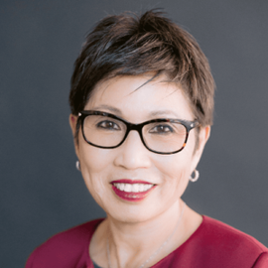
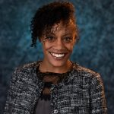

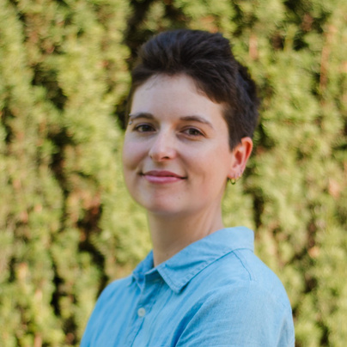





Sacramento/Yolo Subregional Partner Leads
BUSINESS OUTREACH LEAD ORGANIZATION:
COMMUNITY OUTREACH LEAD ORGANIZATION:
Pat Fong Kushida
President & CEO
Sacramento Asian Pacific Chamber of Commerce
Kiara Reed
Executive Director
Civic Thread
Anette Smith
CERF Sub Regional Hub Community Manager
Sacramento Asian Pacific Chamber of Commerce
asmith@calasiancc.org
Kathryn Canepa
CERF Program Lead
Civic Thread
kcanepa@civicthread.org
Notes:
‹#›

Slide 6
WHAT IS THE COMMUNITY ECONOMIC RESILIENCE FUND?
Notes:
‹#›

Slide 7
CERF - What is it?
The Community Economic Resilience Fund (CERF) is a new approach to economic development that seeks to center disadvantaged communities as part of California’s transition to a clean energy, carbon neutral economy, creating good-paying jobs and prosperous communities for all.
Notes:
‹#›

Slide 8

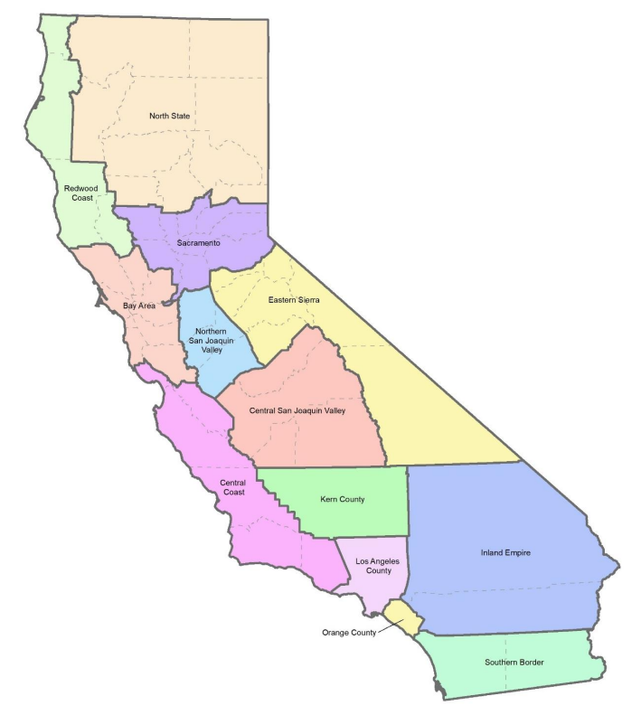



Bringing Jobs & Investments in the Capital Region
$600M program statewide
Advancing regional economies
High Quality Jobs
Equity-centered
Low carbon transition
Catalyze Investments
Notes:
‹#›

Slide 9




Program Goals for our Region
Create a Collaborative
Produce a regional roadmap for economic development
Attract investments into the region
Create accessible high quality jobs
Enabling our region to make collective decisions
Prioritizing the creation of accessible, high-quality jobs in sustainable industries
From diverse sources to maximize impact
To support economic growth and equity
Notes:
‹#›

Slide 10
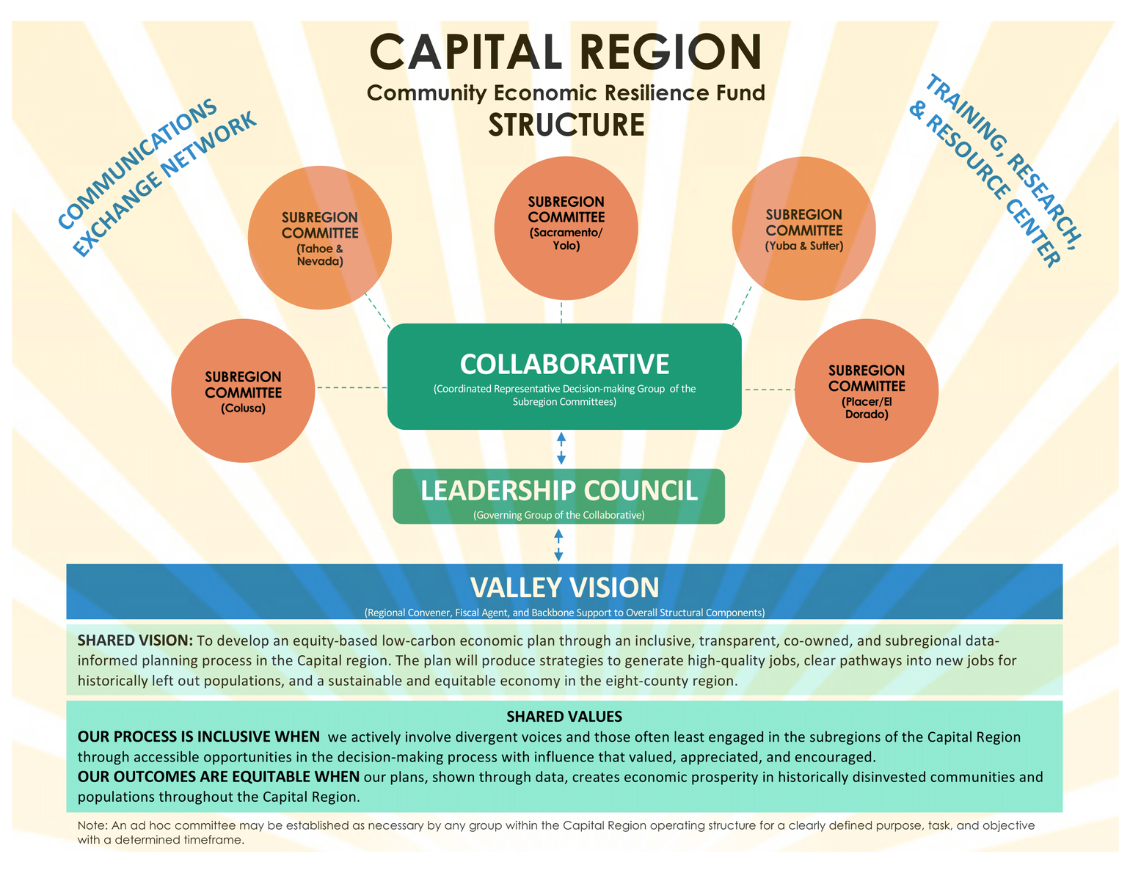
Our Governance Structure
Valley Vision’s Role
Valley Vision is the Regional Convener and Fiscal Agent for the Capital Region. This means Valley Vision is responsible for forming an inclusive Collaborative, ensuring deliverables and outcomes are met, and managing and distributing the funds from the Planning Phase and Catalyst Fund. For our subregional partners, Valley Vision serves as the backbone organization.
8 County Capital Region:
Colusa Sacramento
El Dorado Sutter
Nevada Yolo
Placer Yuba
Notes:
‹#›

Slide 11

CERF Planning Phase Activities
Spring - Summer 2024
$5M in planning funds for our region
Winter 2023-24
Fall 2023
Bring together Leadership Council
Conduct community engagement
Assemble project inventory
Apply for Catalyst Fund
Maintain decision-making bodies
Complete economic roadmap
Launch Catalyst Program
Summer 2023
Conduct economic assessment and conduct research
Launch regional CERF brand
Bring together subregions
Bring on research, communication, and local partners
Start learning together
Spring 2023
Launch program and start building the collaborative
130+ entities
Notes:
‹#›

Slide 12
CERF Outcomes
  Analytic resources to understand opportunity landscape
  Shared ownership of a regional vision of inclusive economic growth
  More capacity to develop projects
  A focus on inclusive opportunities in the low carbon economy
  Clear project pipeline across 8-county region
Millions in investment into building opportunities that benefit communities that have been historically excluded and under invested
Notes:
‹#›

Slide 13
Next Stages of CERF
Catalyst Fund
Up to $14 million to each for CERF regions for project pre-development activities. These investments will bridge the gap between planning and implementation.
Implementation Fund
$268 million statewide for “shovel-ready”/“ready-to-go” projects that align with the Regional Economic Development Strategy Plans and adhere to the program’s core values.
Notes:
‹#›

Slide 14
CERF & OUR REGIONAL PROSPERITY STRATEGTY
Notes:
‹#›

Slide 15

Minority Small Business
Connections to the
Sacramento/Yolo Subregional Table
Pat Fong-Kushida, President and CEO
Wednesday, October 25, 2023
1
Notes:
‹#›

Slide 16
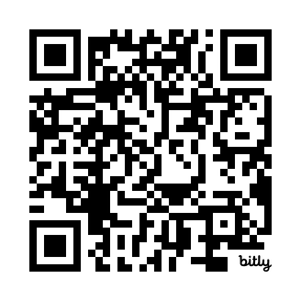

Key Findings from the 2018 Brookings Institute study
The Sacramento region is relatively prosperous compared to other large metro areas, but the region has been on a troubling economic trajectory since 2006.
Brookings recommended:
    Sacramento Region is ranked in bottom third of top 100 U.S. metros for composite scores on growth, prosperity and inclusion
    34% of the Sacramento region’s residents live in struggling families
    The region trails its peers on measures of business dynamism, venture capital investment, and advanced industries growth
    Supporting business cluster development, like mobility, health, and food and Ag to improve job quality and investment
    Help young firms grow strong through technical assistance
    Invest in digital skills training to prepare a diverse workforce for jobs of the future
2
Notes:
‹#›

Slide 17
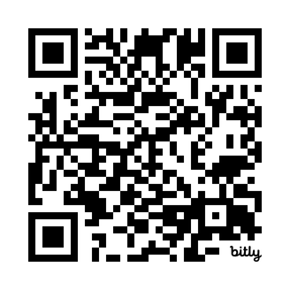
Greater Sacramento Regional Prosperity Strategy
  2020 release. Culmination of two-years of collaborative planning and public engagement across six-county region
  Focuses on three principal goals:
  1. Improve business
  2. Support people
  3. Develop place
  The Prosperity Strategy is a triple bottom line approach ensuring a strong, inclusive, and equitable economy for the people of the Sacramento region
  It serves as the region’s federally recognized Comprehensive Economic Development Strategy, or CEDs
3
Notes:
‹#›

Slide 18
Greater Sacramento Regional Prosperity Strategy
1.
STRATEGY: Be the global leader for entrepreneurs, firms and workforce in food, agriculture and health innovation.
2.
STRATEGY: Be the global leader for entrepreneurs, firms and workforce in life sciences.
3.
STRATEGY: Be the global leader for entrepreneurs, firms and workforce in future mobility.
4.
STRATEGY: Target infrastructure investment to support economic clusters and market drivers.
STRATEGY: Expand demand-driven, sector-based workforce development aligned to key opportunity clusters and a more inclusive workforce, prepared for the future of work.
5.
6.
STRATEGY: Create an environment to be the most business-friendly region in which to operate in the State of California.
4
Notes:
‹#›

Slide 19
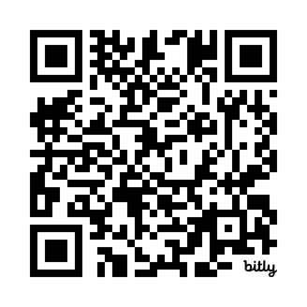
New Beacon Economics research (Fall 2023)
  Commissioned by the California Asian Pacific, Hispanic, and African American Chambers, and underwritten by CalOSBA
  Hired Beacon Economics and Small Business Majority to measure the economic, fiscal impacts of minority small business across all of California
  2019 data from five different data sets, augmented with statewide small business survey involving over 1,000 firms, focus groups, and interviews
Statewide Results
CERF Sacramento Region Results
  45% of all small business, and growing
  $193 billion in economic output per year, which is greater than the annual GDP of 18 U.S. states
  Support 2.56 million jobs
  74,700 minority-owned small businesses
  (Asian 38,900 | Hispanic 33,200 | Black 12,500)
  $7.5 billion in annual economic output
  105,000 jobs supported
  Generate over $1.2 billion in federal, state and local taxes
5
Notes:
‹#›

Slide 20

Inclusive Economic
Strategy
INPUTS:
OUTPUTS:
  Pipeline of diverse entrepreneurs
  Unique market solution
  Risk capital / investment
  Predictable government rules and regulations
  Technical support
  Prepared workforce
  Resilient supply chain
  High road jobs
  Diverse workforce
  Range of career options
  Responsible industries
  Resilient, low carbon supply chain
  Can-do mindset
Food / Ag Cluster
Mobility Cluster
Life Sciences Cluster
Workforce Investments
Infrastructure Investments
Economic Foundations
Best Place to Do Business
6
Notes:
‹#›

Slide 21
CONTACT:
Pat Fong-Kushida, President and CEO
patfk@sacasiancc.org
7
Notes:
‹#›

Slide 22
SACRAMENTO/YOLO SUBREGION
Notes:
‹#›

Slide 23
Collaborative Members in the Sacramento/Yolo Subregion - Slides 1/3
Community Based Organizations (CBOs)
Business
Workforce
  Atrium 916
  California Urban Partnership
  Californians for the Arts
  Civic Thread
  Community Alliance with Family Farmers
  Improve Your Tomorrow
  Kitchen Table Advisors
  Opening Doors
  SacAct
  Yolo County Children's Alliance
  Jakara Movement
  Rural County Representatives of California (RCRC)
  Sacramento Alliance for Regional Arts
  Sacramento Building Healthy Communities
  Juma Ventures
  United Latinos
  Soil Born Farms Urban Agriculture and Education Project
  Teatro Nagual
  Anti-Recidivism Coalition
  The Ring of Democracy
  Greater Sacramento Urban League (GSUL)
  Sacramento Area Bicycle Advocates
  California Capital Financial Development Corporation
  Canon
  Clear Strategies LLC
  Pacific Coast Producers
  Sacramento Asian Pacific Chamber of Commerce
  Sacramento Entrepreneurial Growth Alliance
  Sacramento Hotel Association
  Small Business Majority
  Slavic-American Chamber of Commerce
  California Mobility Center
  Sacramento Metro Chamber of Commerce
  Sacramento Municipal Utility District
  Capitol Impact
  Building Skills Partnership
  Center for Employment Opportunities
  North Central Counties Consortium
  North State Building Industry Foundation
  ReScape California
  Sacramento Employment & Training Agency (SETA)
  Pivot Sacramento
Environmental
  Global Urban Nomads
  Grid Alternatives
  Sacramento Clean Cities Coalition
  Sierra Nevada Alliance
  South Fork of the American River Collaborative
  City of Trees Foundation
This is a list of CERF Collaborative Members who live in, provide services to, or represent community groups within Sacramento and Yolo Counties.

Slide 24
Collaborative Members in the Sacramento/Yolo Subregion - Slides 2/3
Government
Labor
Economic Development
  Assembly Member Aguiar-Curry
  City of Elk Grove
  City of Rancho Cordova
  City of Sacramento (Councilmember Mai Vang)
  City of Sacramento (Office of Mayor Steinberg)
  City of Sacramento (Office of the City Manager)
  City of West Sacramento
  City of Woodland
  Sacramento County
  Yolo County
  County of Yolo, Department of Community Services
  County of Yolo, Workforce Innovation Board
  Institute for Local Government
  Sacramento Area Council of Governments
  Associated Builders and Contractors, Northern California Chapter
  Center for Workers' Rights
  International Brotherhood of Electrical Workers, Local 340
  Sacramento Central Labor Council AFL-CIO
  Ironworkers Apprenticeship
  California Forward
  Carlsen Center for Innovation & Entrepreneurship
  Community Strong Strategies
  Greater Sacramento Economic Council
Education
Community Members
  California State University, Sacramento
  County of Yolo, Office of Education
  Los Rios Community College District
  Roseville Adult School
  University of California, Davis
  Inspirame
  ProjectAttain!
  University of California, Agriculture and Natural Resources
  Tiffany Wilson
This is a list of CERF Collaborative Members who live in, provide services to, or represent community groups within Sacramento and Yolo Counties.

Slide 25
Collaborative Members in the Sacramento/Yolo Subregion - Slides 3/3
Philanthropy
Food & Ag
Health
  Sacramento Region Community Foundation
  Sierra Health Foundation: Center for Health Program Management
  United Way
  Sacramento Food Policy Council
  AgStart
  Kaiser Permanente
This is a list of CERF Collaborative Members who live in, provide services to, or represent community groups within Sacramento and Yolo Counties.

Slide 26
MAPPING OUR WAY FORWARD AS THE SACRAMENTO/YOLO SUBREGION
Notes:
‹#›

Slide 27
Mapping Our Way Forward in the Sacramento/Yolo Subregion
NOVEMBER
DECEMBER
JANUARY
  November 13th - Collaborative Meeting to learn more about Initial Research Findings for our region
  November 15th - Monthly Sac/Yolo Committee Meeting
  Continue community Engagement
  December 13th - Monthly Sac/Yolo Committee Meeting
  Continue Community Engagement
  January 24 - Monthly Sac/Yolo Committee Meeting
  Subregions begin soliciting projects for the Implementation Fund
  Continue Community Engagement
FEBRUARY
MARCH
APRIL
  Subregions discuss projects for the Implementation Fund
  Continue Community Engagement
  Continue Implementation Project Discussions
  Continue Community Engagement
  By the end of April, each subregion may submit up to 3 recommended Implementation Projects to the Leadership Council
Notes:
‹#›

Slide 28
Key Meeting Dates for the Sacramento/Yolo Subregion
Monthly Meeting Dates:
  November 15th - 6:00 to 7:30 PM - Arthur Turner Community Room in West Sacramento
  December 13th - 6:00 to 7:30 PM - Location TBD
  January 24th - 5:30 to 7:30 PM - Location TBD
Other CERF Meetings:
  November 13th - 3:30 to 5:30 PM - Research Presentation (zoom)
Notes:
‹#›

Slide 29
COMMUNITY ENGAGEMENT BRAINSTORMING
Notes:
‹#›

Slide 30
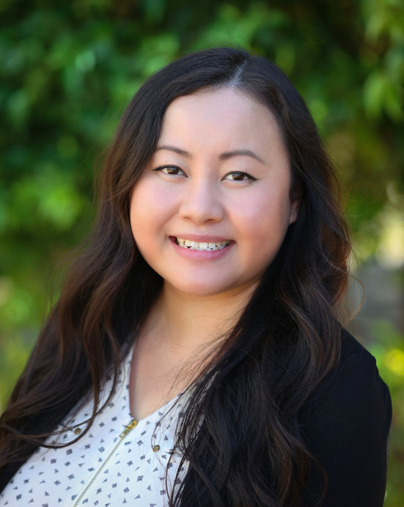
Session Facilitator
Maikhou Thou
Everyday Impact Consulting
Notes:
‹#›

Slide 31
ADDITIONAL INFORMATION
Notes:
‹#›

Slide 32

livabilitysummit.org
Notes:
‹#›

Slide 33
Staying Connected!
Email us at cerf@valleyvision.org
or visit us at https://bit.ly/SacCERF to subscribe to our CERF newsletter & view additional resources
Evan Schmidt
CEO
evan.schmidt@valleyvision.org
Maritessa Bravo Ares
Project Leader
maritessa.ares@valleyvision.org
Alana Ramsay
Project Manager
alana.ramsay@valleyvision.org

Slide 34
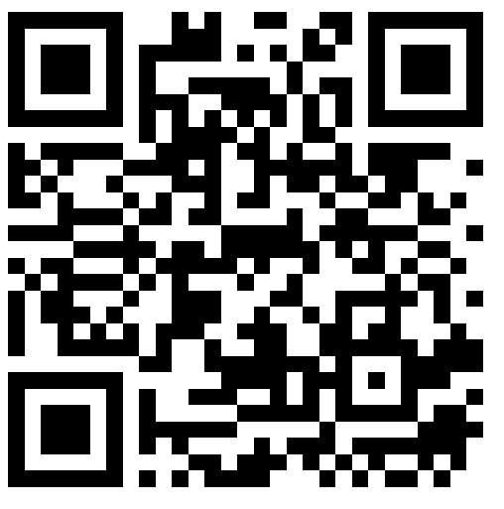
Survey!
Thank you for attending the first of many CERF Subregional Committee meetings. Please complete the survey so we collect your thoughts!
Notes:
‹#›

