Slide 1
Imagine your childhood home…

Slide 2
Housing affordability
Widening income and racial inequality
Disruptive impacts of new technologies and industries
Changing
real estate landscape
Climate change and adaptation
Notes:
There are many issues facing our cities

Slide 3
Housing affordability
Widening income and racial inequality
Disruptive impacts of new technologies and industries
Changing
real estate landscape
Climate change and adaptation
Notes:
These are the two I focus on

Slide 4
Let's explore:
How do we address looming concerns of displacement?
How do we build transformative economics without displacement?

Slide 5
How can we address looming
concerns of displacement?

Slide 6
GENTRIFICATION
A process of neighborhood change where higher-income residents and businesses move into an underinvested community, resulting in a higher cost of living that strains existing residents.
DISPLACEMENT
Occurs when residents and business owners can no longer afford to remain in their buildings due to increased housing and leasing costs or are forced out by lease non-renewals, evictions, eminent domain, or poor physical conditions.
Source: Uprooted Project, University of Austin, Texas. https://sites.utexas.edu/gentrificationproject/understanding-gentrification-and-displacement/
Zuk, Beirbaum, et.al “Gentrification, Displacement, and the Role of Public Investment: A Literature Review”, Federal Reserve of San Francisco, August 2015

Slide 7
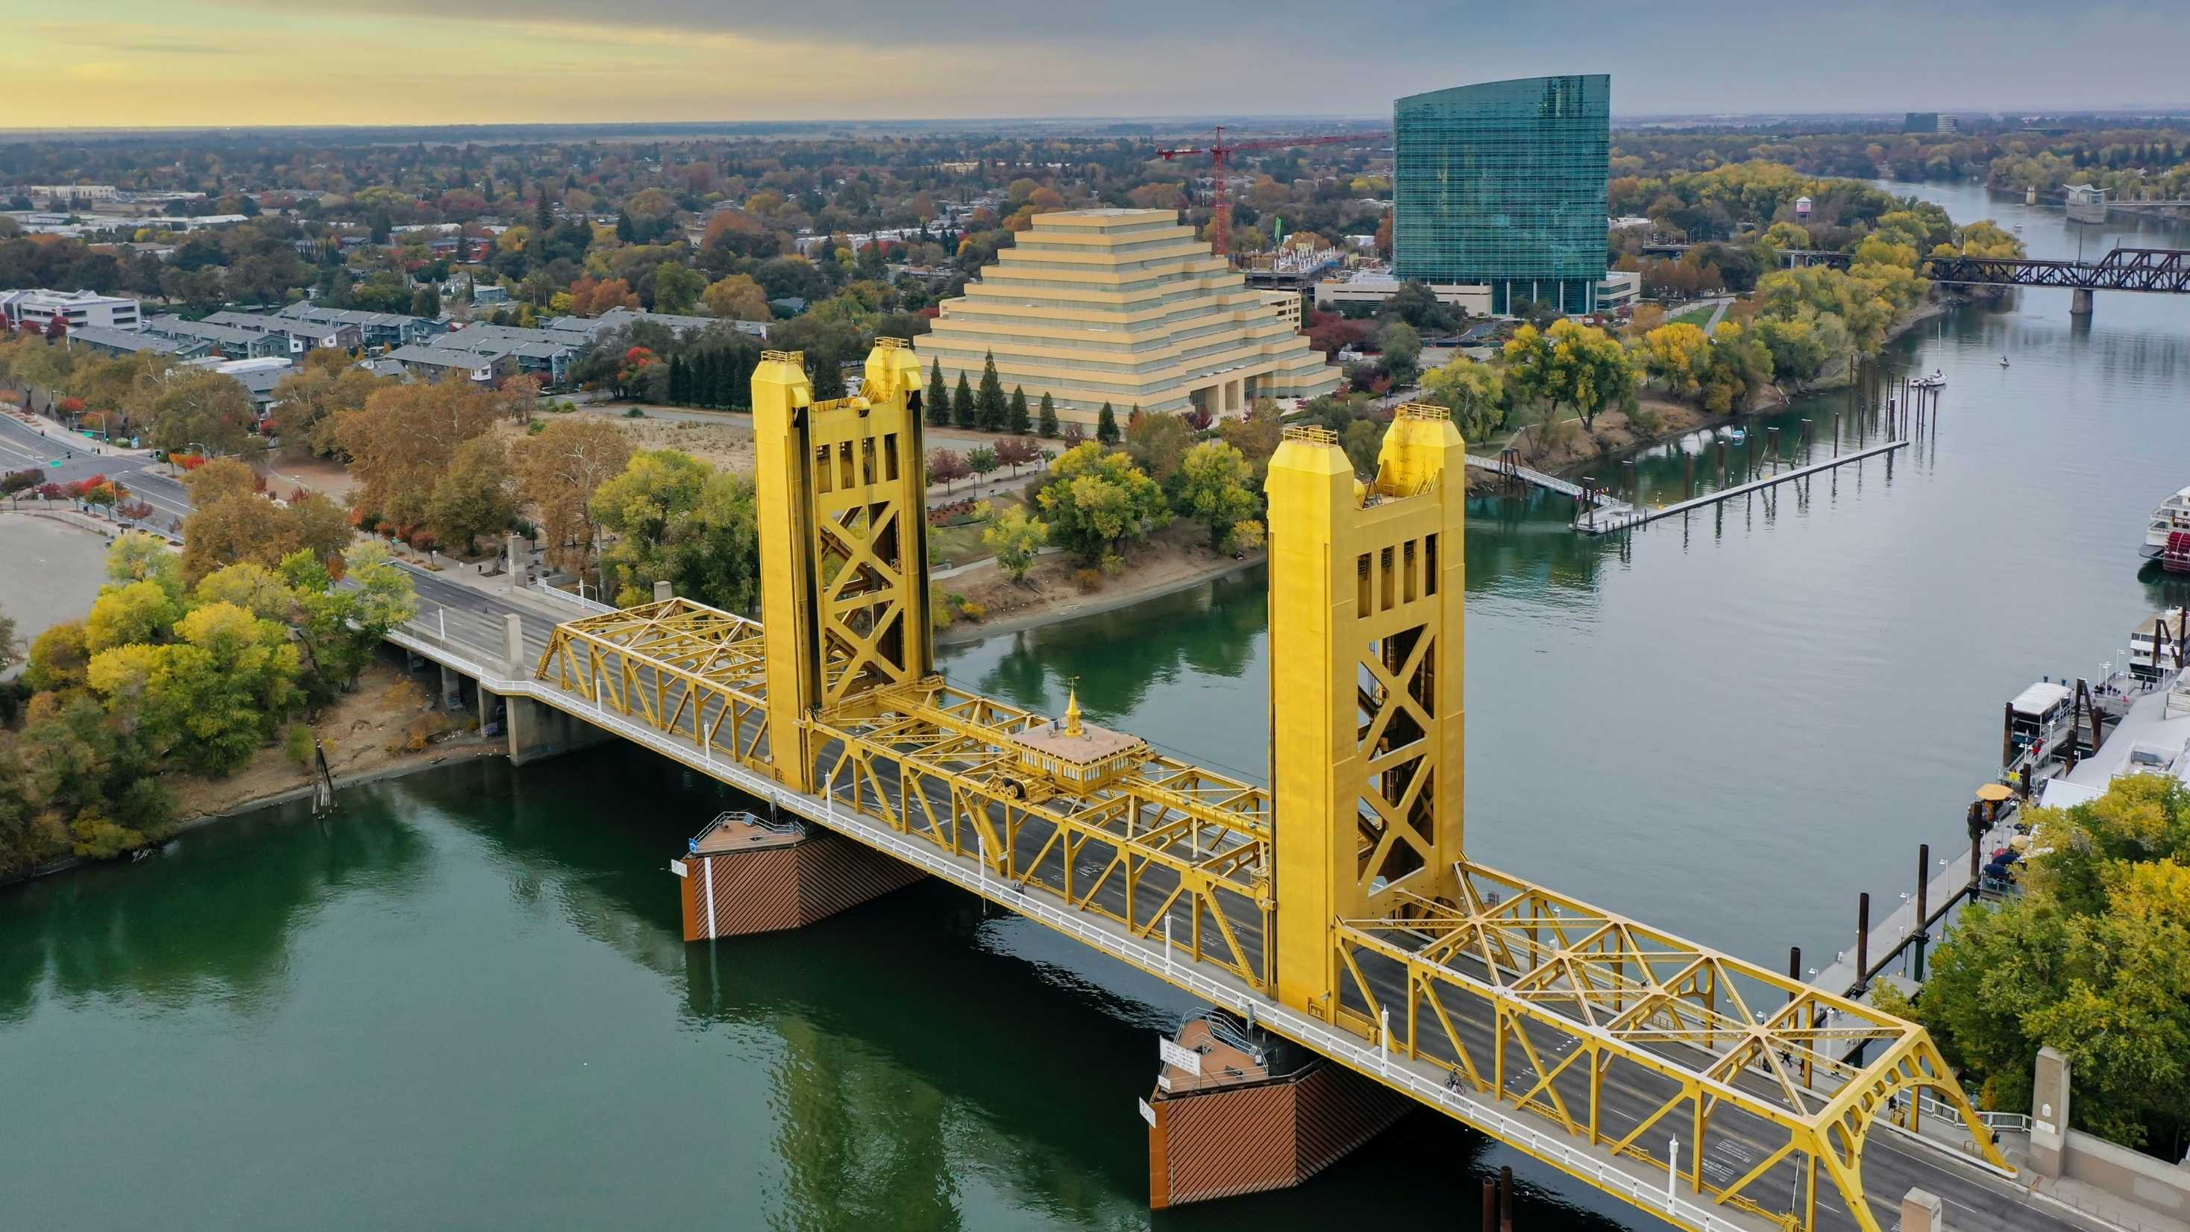
SACRAMENTO, CA
1 MILLION
Homes needed in the state of California for extremely low-income renters
62,000
Homes needed in Sacramento MSA for extremely low-income renters
Source: National Low Income Housing Coalition’s March 2023 Report. The Gap: A Shortage of Affordable Homes
Notes:
National Low Income Housing Coalition’s March 2023 Report
The Gap: A Shortage of Affordable Homes

Slide 8
SACRAMENTO, CA
27 Affordable & Available Homes
Per 100 extremely low-income households in the Sacramento MSA in 2021
Source: National Low Income Housing Coalition’s March 2023 Report
Source: National Low Income Housing Coalition’s March 2023 Report. The Gap: A Shortage of Affordable Homes

Slide 9
SACRAMENTO, CA
+47%
Median gross rent increase in the Sacramento MSA from 2017 to 2022
Source: National Low Income Housing Coalition’s March 2023 Report
Source: National Low Income Housing Coalition’s March 2023 Report. The Gap: A Shortage of Affordable Homes

Slide 10
SAN DIEGO EVICTIONS STUDY

Slide 11
SAN DIEGO EVICTIONS STUDY
"Difficulty Finding Housing I Could Afford"
Top difficulty related to renting

Slide 12
SAN DIEGO EVICTIONS STUDY
"Inability to Keep up with Rent Increases"
Top reason for experiencing difficulty paying rent

Slide 13
Trauma from housing stability can negatively impact child development.
SD EVICTION STUDY TAKEAWAYS, GARRETT TO ADD
Source: The Impact of Evictions on Preterm Births and Family Health Outcomes, University of California, Berkeley (2021).
Notes:
"Children under 5 make up the largest group by age of those whose households have had an eviction filed against them.
Eleven percent of all children under 5 in rental households face eviction each year. And the rate is 27 percent for Black children under 5 in rentals.
Livability poll found that Black people and people of color are challenged most by...

Slide 14
How do we address displacement?
Support Economic Mobility
Expand the
Supply of Housing
Strengthen Tenant Protections

Slide 15
How can we build transformative economics without displacement?

Slide 16
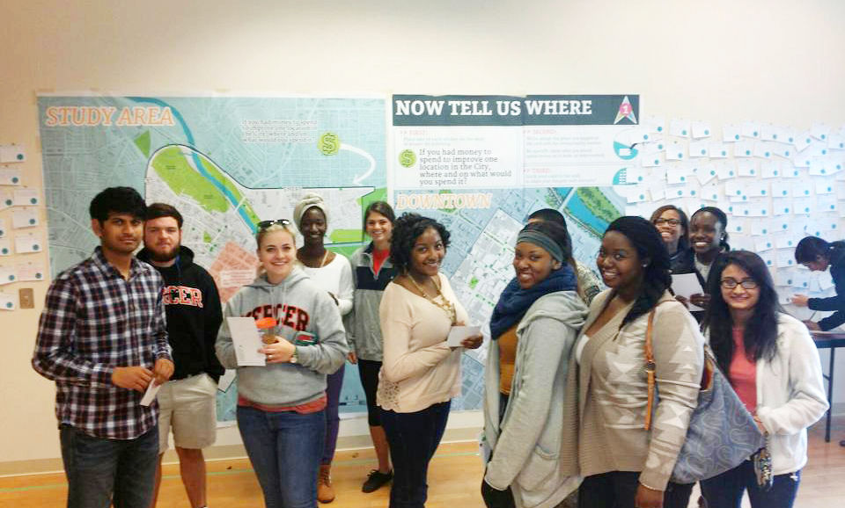
Community must
be at the table…
Photo Source: Macon Action Plan

Slide 17
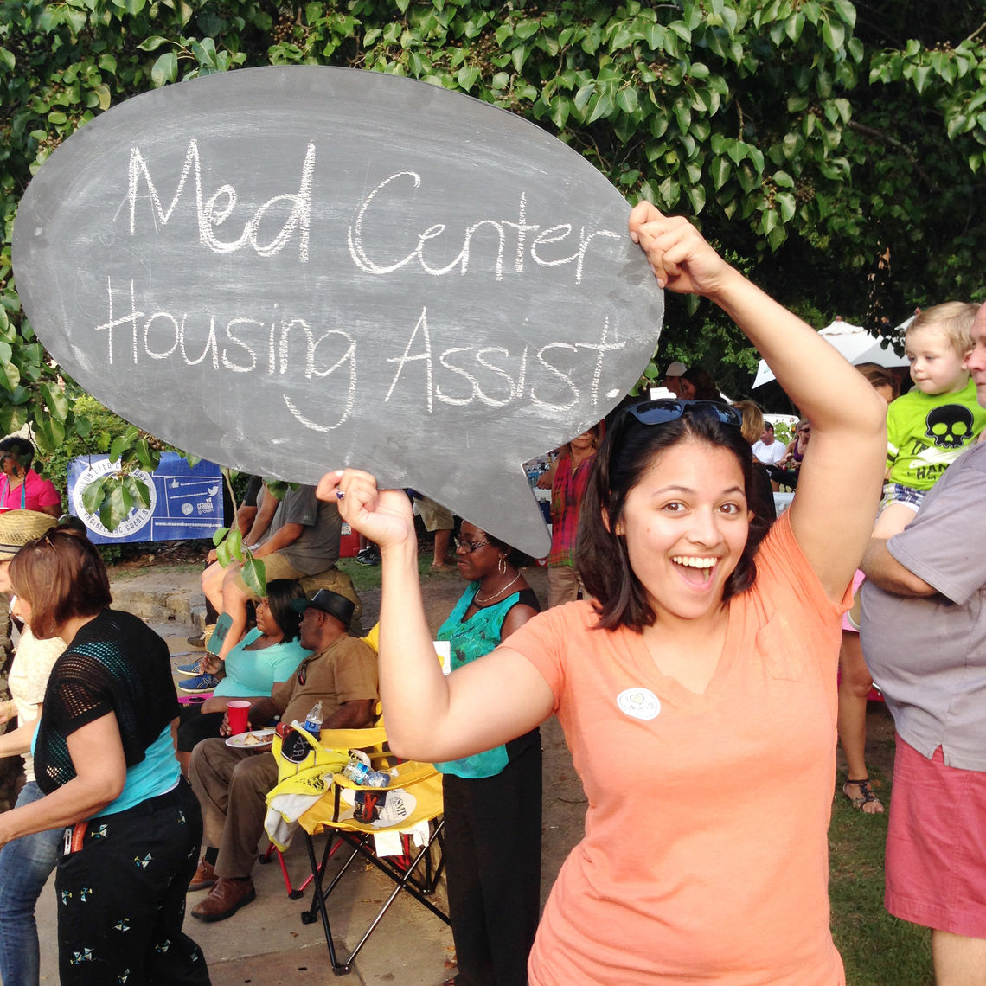
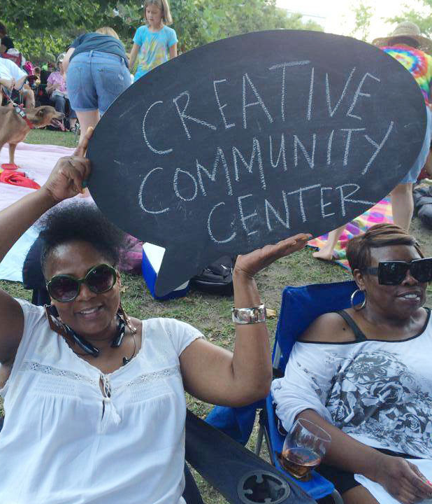
MACON ACTION PLAN
Building a Shared, Actionable Vision
Collaboration and shared accountability among organizations
Democratizing revitalization activities
Photo Source: Macon Action Plan

Slide 18
MACON ACTION PLAN
129
“Downtown Challenge” grants implemented
71
New restaurants, bars and venues
2020
80%
Action Plan strategies implemented (93% underway for the Macon Action Plan 2.0)
Photo Source: Macon Action Plan
Notes:
40 restaurants in Downtown Macon about a 1/2 sq mile, an area approximately 1/10th the size of Sacramento.

Slide 19
… and they must be supported.
Source: Darrel Ellis

Slide 20
Revenues of Black-led organizations are 24% lower than white-led organizations
Source: The Bridgespan Group & Echoing Green, 2020; Darrel Ellis

Slide 21
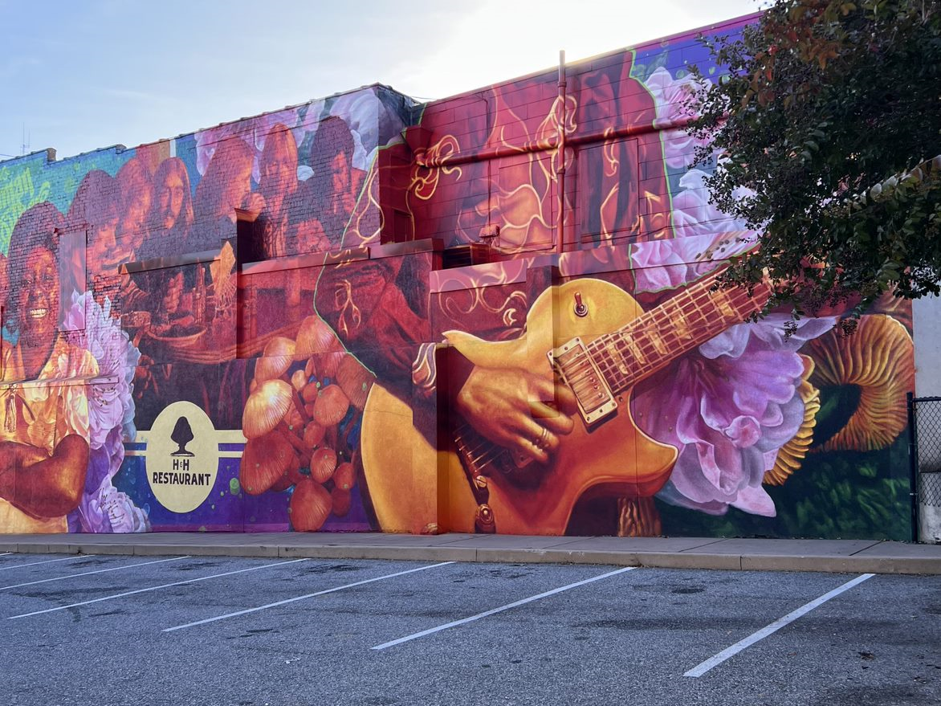
Transformative economics
does not happen overnight.

Slide 22
We must restructure
our systems to meet
community needs.

