Slide 2
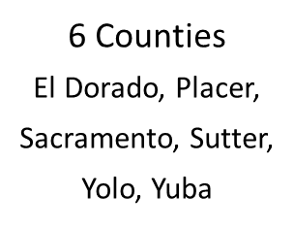
At a Glance...
1,421
Respondents
1.8% Margin of Error
Weighted to Demographically Represent the Region
in the field

Slide 3
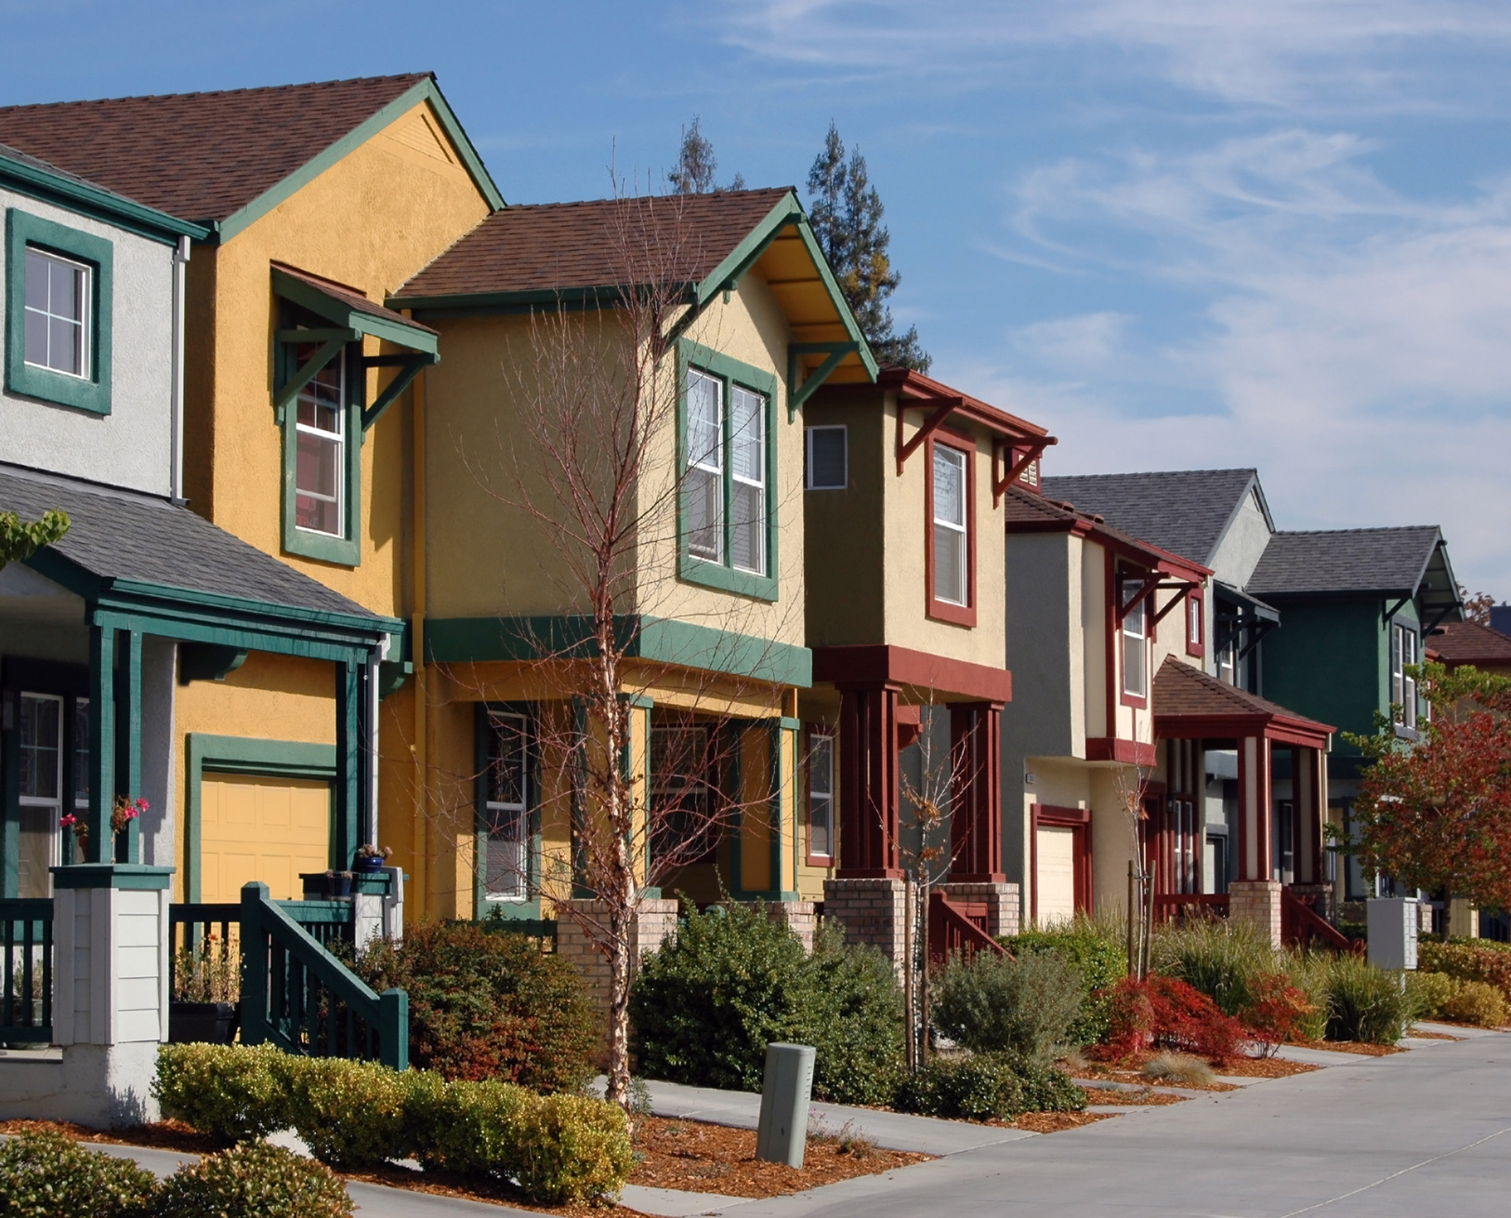
What is livability?
Notes:
Housing
Food
Healthcare
Transportation
Open space and neighborhood amenities
Special places
Access to opportunity
Non-quantifiable things, like civic engagement and acceptance

Slide 4
Livability for All: the headlines

Slide 5
Livability for All: the headlines

Slide 6
Livability for All: the headlines

Slide 7
Livability for All: the headlines

Slide 8
Livability for All: the headlines

Slide 9
Features Ranked Most Important to Quality of Life
52%
48%
33%
33%
33%
33%
Natural spaces, trails, and community assets make the Sacramento region special
Natural Spaces
Recreational Facilities
Community Centers
Events and Festivals
Outdoor Markets
Retail Shops
Notes:
There are also notable trends among our diverse population: residents aged 55+ and those with a household income of less than $50,000 are more likely to indicate that public facilities such as libraries and community centers are important to their quality of life.

Slide 10
The Sacramento region offers a good place to grow up, pursue a career, and raise a family but is deemed less desirable when purchasing a home and retiring
Excellent/Good
Fair/Poor
Introduce the company's main competitors.
Grow Up
77%
23%
The Sacramento Region Ranks as a Good or Excellent Place to...
Raise a Family
76%
74%
Pursue a Career
73%
27%
Retire
49%
52%
Purchase a Home
41%
59%
0
25
50
75
100
125

Slide 11
Job, housing, and health conditions remain steady for most
Better
The Same
Worse
Your Financial Situation
39%
24%
37%
Changing Conditions in the Last 5 Years
Your Job Opportunities
24%
63%
13%
Your Housing Situation
24%
58%
18%
Your Mental Health
23%
51%
26%
0%
25%
50%
75%
100%
Notes:
Those with different incomes have different experiences when it comes to their perception of the last five years, with those in the highest income reporting the best conditions and those in lower income categories reporting less improvement in housing, finances, and job opportunities. The youngest demographic also noted the mot improvement in conditions over the last 5 years.

Slide 12
Issues Identified as the Most Important to Quality of Life
60
55%
47%
40
38%
37%
When it comes to quality of life, affordable housing and livable wages top the list
29%
25%
20
18%
0
Livable Wages
Quality Education
Climate Resilience
Affordable Housing
Accessible Healthcare
Respect AcrossPolitical Party Lines
Inclusive Communities

Slide 14
Feelings of Anxiety and Depression by Demographic
anxiety or stress at least weekly
depressed or hopeless at least weekly
65%
Black
49%
54%
Asian
35%
Mental health issues remain challenging, especially for communities of color and younger people
51%
Hispanic
23%
43%
White
22%
76%
Other
28%
0%
20%
40%
60%
80%

Slide 15
Notes:
“I worry about my safety in regards to environmental issues such as air quality, wildfires, flooding, and drought conditions. “
‘I worry about property crime, like car or home break-ins. “

Slide 16
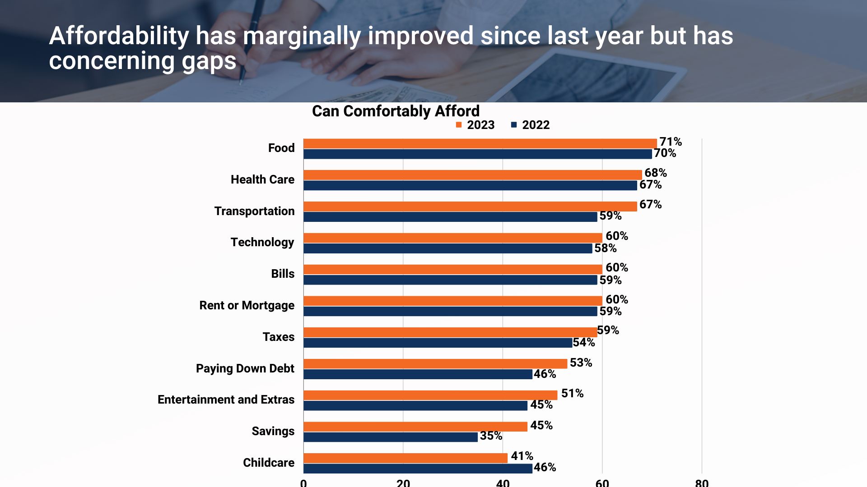

Slide 17
Focus Issue: Affordable Housing

Slide 19
Housing cost burden furthers racial equities
75
Struggling to Afford Rent/Mortgage, by Race
Pay 50%+
Pay 30-50%
60%
68%
28%
40%
21%
50
18%
18%
28%
47%
45%
20%
23%
23%
18%
20%
34%
23%
25
30%
0%
Black (NH)
Hispanic
Asian (NH)
White
All Races and Ethnicities
0
Black
Hispanic
Asian
White
Other

Slide 20
Increasing housing production is an important part of the answer
According to the Mind the Gap - SACOG Housing Initiative, our region has struggled to build enough multifamily housing products in existing communities.

Slide 21
Homeownership is becoming less attainable
Do you think first-time home buyers will have a more difficult time finding housing in the next five years?
No
21%
Yes
79%
2022 Built Environment Poll

Slide 22
Focus Issue: The Care Economy
59%
34%
36%
Respondents with children who cannot or can barely afford childcare
Respondents who need childcare but can’t access it
Respondents who need senior care but can’t access it
Childcare is the only essential service that has gotten less expensive since last year

Slide 23
Childcare and the Care Economy Challenges
There is capacity for 24% to 36% of the region’s children in existing childcare spaces (kidsdata) and childcare.
94 - 99% of childcare workers are female
70% of family childcare home providers and center teachers are in nonwhite categories.
80% Of the family childcare home workforce is age 40 and older
Childcare workers and preschool teachers make well below a living wage in the Greater Sacramento Region.
40
$37.27
30
20
$16.68
$13.74
In a poll Valley Vision conducted of 224 current childcare workers from April through July of 2022, 53% had considered changing careers, primarily due to wages (92%).
10
0
Living Wage
Preschool Teachers
Childcare
Notes:
workforce issues is prevalent
most vulnerable people are in the field
Lack of value of the care economy is driving - until we start to value the care economy -mostly female, 80% 40 and older, hispanic
because it also affects the ability for workers (espe. women) opportunities in the workforce
new workers aren't coming in
no one can afford to do these jobs
the broader definition of infrastructure for CA should include care economy

Slide 24
Focus Issue:
Social Mobility and the Future of Work
Social mobility is supported by a degree of financial security supported by livable wage, access to education and promotion, and a secure future.

Slide 25
Employment Satisfaction by Age
Satisfied
Not satisfied
18-34
68%
32%
Nearly 80 percent of employees are satisfied with their jobs and almost 70 percent report that their employer offers a fair wage.
35-54
83%
17%
55+
87%
13%
0
25
50
75
100

Slide 26
Annual self-sufficiency wage for families in Capital region, by family type
One adult, one infant
Housing
Childcare
Food
Transportation
Health Care
Misc.
Emergency Savings
Retirement Savings
Taxes
El Dorado
$85.668
Placer
$83.856
Yolo
$83.082
Nevada
$77.705
Sacramento
$74.384
Sutter
$69.131
Yuba
$66.240
Colusa
$63.650
0
25,000
50,000
75,000
100,000
Source: Brookings and Cities GPS analysis of University of Washington Self-Sufficiency Standard for California 2021. Brookings adds taxable emergency savings and non-taxable retirement savings to the self-sufficiency standard.

Slide 27
Getting Ahead - Ability to Save Money
Can Comfortably Afford Savings by Income
Can Comfortably Afford Savings by Age
>$50k
21%
18-34
35%
$50-150k
47%
35-54
45%
$150k+
66%
55+
45%
0
25
50
75
0
20
40
60
Notes:
Getting more people to livable wages and ability to save for the future is a critically important challenge for our region to support prosperity for all. Job creation and inclusive pathways into good jobs is the work ahead and we are going to spend some time later today diving into that topic.

Slide 28
Trends in Remote Work
By Income
By Race
>$50k
Black
19%
19%
Other
34%
$50-150k
45%
White
51%
$150k+
70%
Asian
55%
0
25
50
75
0
20
40
60

Slide 29
New Technologies in the Workplace
Effects of Innovations and Technology in the Workplace
Harm
Improve
Collaboration
32%
23%
in the Workplace
Your value
34%
21%
as an Employee
Your ability to obtain
32%
21%
and keep a job
Your income
37%
17%
0
20
40
60

Slide 30
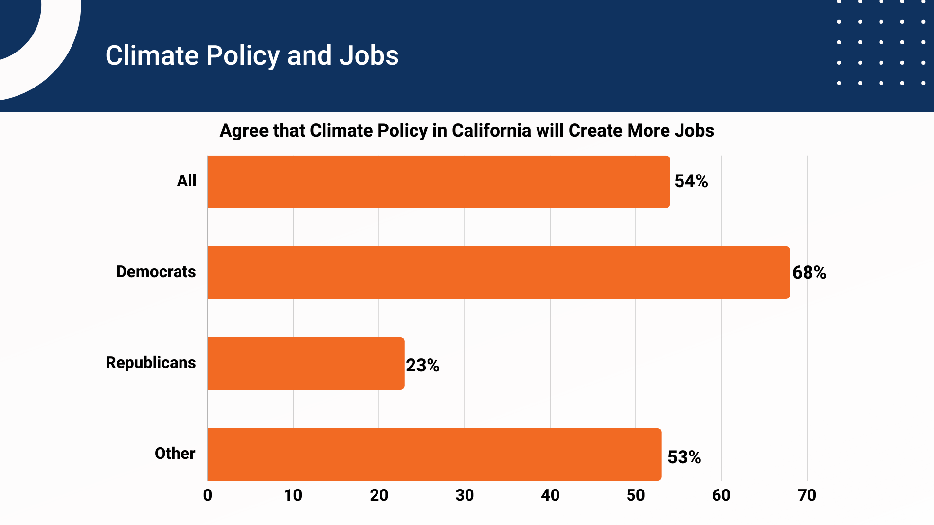

Slide 32
My opinion matters in local, state, and federal elections
Acceptance and Voice
Disagree
44%
Agree
56%

Slide 33
Catalyzing Action: Ideas to Achieve a Livable Future
Accelerate housing development, especially infill and transit oriented
Address persistent gaps in the social safety net
Address workforce challenges in the care economy to increase regional capacity
Build a pipeline of promising and good jobs
Fully integrate climate resilience with inclusive economic development actions
Develop a collaborative and healthy civic culture to increase the potential for transformation

Slide 34
Notes:
Our full Livability Poll report, which you can access through the QR code on page 11

